Slide 2
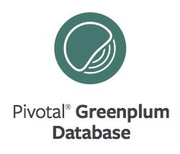
GPDB Storage Considerations
Notes:
Intro: my name is, my role is, …

Slide 3
Agenda
Introduction
Tablespaces and filespaces
Additional table types (external, temp)
Table storage models
Compression options
Test it out in the lab
Notes:
*NOT* The Big Data Haiku
- here is my data
- store it on the cloud for me
I do not care how
Storing and processing large volumes of data is not trivial. This module explores various aspects of storing your data in the most advantageous way.
As an example, the demo will illustrate storing a 1,564,640 row table in the space of an 832 row table.
The more you work with data, the more obsesesive you become over how it’s stored, because making the right choices yields immense benefits in terms of speed and storage economics.
So, let’s jump right in …

Slide 4






Filespaces
Master Servers
Logical volume
Filespace
/data/master/gpseg-1
Filespace
Tablespace
Segment Server
/data/primary/gpseg#
SALES database
MKTG database
Logical volume
/data/mirror/gpseg#
By default, the system filespace, pg_system, is created on initialization
All system relations are stored in the system filespace by default
All user relations are also stored in the system filespace by default
Notes:
A filespace is a pointer to a specific storage area defined on your filesystem. The filespace maps to a set of locations used by the master, standby, and segment hosts.
The system filespace, pg_system, is automatically created on initialization and is used to store system and user relations. In the example shown, the filesystem that supports this filespace is associated with the /data directory. Data is stored as follows:
Master and standby master store files in the /data/master directory.
Primary segments store their files in /data/primary while mirror segments store their files in /data/mirror.
Unless otherwise specified, all tables and other database objects you create are stored within the system filespace.
Note that the filespace is tied to a location on the filesystem and not necessarily to the filesystem root.
Multiple filespaces can share the same filesystem by pointing to different directories that exist on the filesystem.

Slide 5
Tablespaces
Master Servers
Logical volume
Filespace
/data/master/gpseg-1
Filespace
Tablespace
Segment Server
/data/primary/gpseg#
SALES database
MKTG database
Logical volume
/data/mirror/gpseg#
Tablespaces sit atop filespaces interacting with the underlying filesystem
A filespace can support multiple tablespaces
Two tablespaces are created on initialization: pg_default and pg_global
Notes:
A tablespace interacts with the underlying filesystem by being associated with a specific filespace. A filespace can host multiple tablespaces.
Tablespaces allow database administrators to effectively segregate data and take advantage of different storage profiles.
Within Greenplum, you can assign database objects, such as databases, tables, and indexes, to a specific tablespace.
Two tablespaces are defined by default:
pg_default is the default tablespace used to store the default system databases, template0 and template1, as well as any other user-related database objects.
pg_global is used to store the shared system catalog.

Slide 6


Filespace and Tablespace Implementation – Use Case
sales_tbl
Partitioned table
2016
2015
2014
user_s1_tspc
For temporary and transaction files
user_s7_tspc
Relations in this space are on slower storage (in comparison to SSDs)
fs_data1
fs_data_tmp
/drs_vg1_data
/drs_vg2_data
/drt_vg1_data
Relations in this area are associated with faster storage
SSD
SAS 15K RPM
Notes:
Greenplum is not aware of the underlying filesystem. Instead, it relies on you creating the filesystem and associating a filespace with this filesystem.
You can see great benefits by maintaining multiple filespaces to meet the needs of GPDB users. Your requirement may be to provide faster performance on data that is frequently used, placing older, less-often used data on slower disks.
Here’s an example: by defining one filespace on faster SSD disks and another on relatively slower SAS or SATA drives, you meet your SLAs while keeping storage costs managable.
In this example, partitions of a table, sales_tbl, are placed on separate tablespaces. Through the tablespace, user_s1_tspc, the partition containing data for the current year is stored on your SSD drives. The remaining two partitions are in a different tablespace, which is associated with a slower, but higher capacity, type of disk. With the majority of the queries running against the current year’s data, your users experience the faster performance of the SSD drives; simulltaneously, you are able to manage storage costs by housing the historic data on less expensive disk drives.
A third filespace, fs_data_tmp, is used to store temporary and transaction files. Because these files are created as queries are executed, moving these temporary and transaction files to a filespace on faster storage can further improve overall performance.

Slide 7
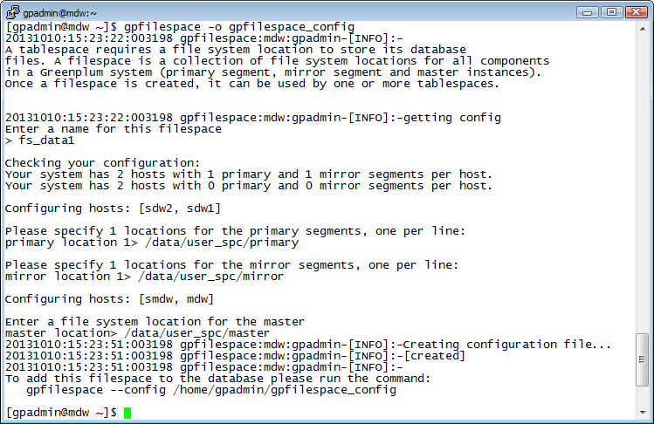
Creating the Filespace Configuration File
All directories must exist and be owned by gpadmin
Directories must already exist on segment hosts
Directory must already exist on master and standby master hosts
Notes:
To create a tablespace, you must first create the underlying filesystem and related filespace.
Before creating the filespace:
Ensure the directory that the filespace will be associated with already exists on the master, standby, and segment hosts. For example, the directory on the master and standby master could be /data/user_spc/master. The directory for the primary segments could be /data/user_spc/primary, while the mirror segments would use /data/user_spc/mirror.
The directories you create must be owned and be writable by the gpadmin user.
Creating and Applying Tablespaces – Filespace Configuration File (Continued)
To create the filespace:
As a database superuser, use the command, gpfilespace -o config_file, to create the configuration file that will be used to create the filespace, where config_file is the file to be created.
You will be prompted for each primary segment directory and mirror segment directory on all segment hosts.
You will be prompted for the master and standby master directory. This directory is the same on both systems, so this is entered only once.

Slide 8


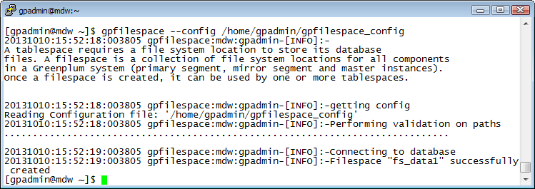
Creating the Filespace
Example: Filespace Configuration File
$ cat gpfilespace_config
filespace:fs_data1
mdw:1:/data/user_spc/master/gpseg-1
smdw:6:/data/user_spc/master/gpseg-1
sdw2:3:/data/user_spc/primary/gpseg1
sdw2:4:/data/user_spc/mirror/gpseg0
sdw1:2:/data/user_spc/primary/gpseg0
sdw1:5:/data/user_spc/mirror/gpseg1
Configuration file contains all directories needed by masters and segments
Create the filespace as the gpadmin user using the filespace configuration file
Notes:
Once the filespace configuration file has been created, you can use it to create the filespace.
To create the filespace, as the gpadmin user, issue the command:
gpfilespace --config config_file
where config_file represents the file created as the output of the previous step (previous slide).

Slide 9
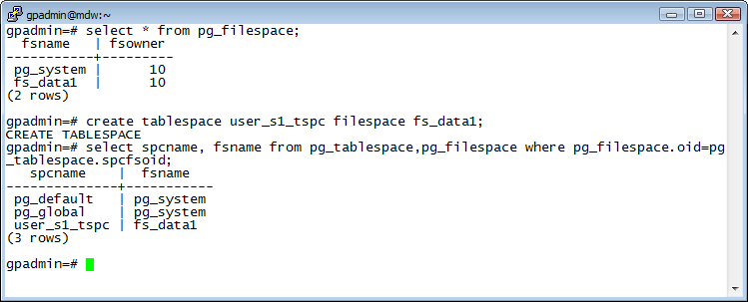


Creating the Tablespace
Usage: Syntax to create a tablespace
gpadmin=# CREATE TABLESPACE tablespace_name [OWNER username]
FILESPACE filespace_name;
Must be unique
The tablespace has now been successfully created
Note: The maximum number of tablespaces and filespaces are represented as gp_max_tablespaces and gp_max_filespaces in the master postgresql.conf file.
A fly and a flea in a flue
Were imprisoned, so what could they do
Said the fly, let us flee. Let us fly said the flee
So they flew through a flaw in the flue.
A canner exceedingly canny
One morning remarked to his granny
A canner can can anything that he can
But a canner can’t can a can can he?
Notes:
Creating the tablespace defines an in-database relationship between the tablespace and the filespace you created.
The tablespace name must be distinct from other tablespaces in the database.
To create the tablespace, enter the following SQL command as a database superuser:
CREATE TABLESPACE tablespace_name FILESPACE filespace_name
As the database superuser, you can assign the tablespace to a non-superuser during the creation process, or afterwards, using: “ALTER TABLESPACE index_space OWNER TO scott;”
Note that the tablespace name cannot begin with gp_ or pg_ as these prefixes are reserved for system tablespaces.

Slide 10
Applying the Tablespace
Object | Example
Database | CREATE DATABASE tt_db TABLESPACE user_s1_tspc;
Table | CREATE TABLE tt_rt (id int) TABLESPACE user_s1_tspc;
Partitioned Table | CREATE TABLE ttct2_part_rt (id int, id2 int) PARTITION BY LIST (id) ( PARTITION one VALUES (1), PARTITION two VALUES (2) TABLESPACE user_s1_tspc, PARTITION three VALUES(3) );
Index | CREATE INDEX tt_idx ON tt_rt (id) TABLESPACE user_s1_tspc;
Note: The default tablespace for the environment can be set by modifying the default_tablespace parameter in the master server’s postgresql.conf file.
A fly and a flea in a flue
Were imprisoned, so what could they do
Said the fly, let us flee. Let us fly said the flee
So they flew through a flaw in the flue.
A canner exceedingly canny
One morning remarked to his granny
A canner can can anything that he can
But a canner can’t can a can can he?
Notes:
When creating a database, table, or index, you can specify the tablespace to create the database object in.
When you do not specify the tablespace while creating an object, the default tablespace for the database is used.
You can change the default tablespace for users in Greenplum by modifying the default_tablespace parameter in postgresql.conf on the master server.

Slide 11

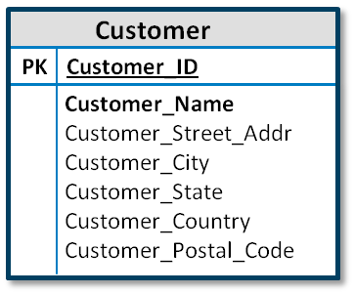


Additional Table Types
Readable external table
Temporary table
Writable external table
Temporary tables can be used for:
Storing transient results needed for other session queries
Perform transformations on data
External tables:
Facilitate parallel data loading
Stream data in from external sources
Push data out of the database, in parallel
Notes:
Greenplum Database provides support for a variety of table types to facilitate data processing and data loading or unloading. In addition to regular tables, the following table types are supported:
Temporary tables – These are often used to store the results of queries that are required for a short period of time, during a single connection session, or for transforming data during an ELT process.
External tables – External tables are used to facilitate data loading and unloading. They can be useful in a variety of applications, including to retrieve a stream of data from an external source, such as from Hadoop HDFS, a REST service, or an operating system command. They can also be used to move data between databases.

Slide 12
Temporary Tables – Overview
Session-specific
Dropped at the end of the session
Take precedence over permanent tables of the same name
Created in a special schema created on connection to a session
Are distributed
Can be indexed and analyzed
Notes:
Temporary tables in Greenplum Database are session specific, are not shared across sessions, and are automatically dropped at the end of the session.
If you are not referencing tables by their schema-qualified names, a temporary table takes precedence over a permanent table with the same name.
Temporary tables are automatically created in a special schema and cannot be assigned to a schema of your choosing.
These schemas are automatically created when you connect to a session, and are named to reflect the session’s connection ID (e.g. “pg_temp_32685”).
Temporary tables and permanent tables are similar in the following ways:
You specify a distribution key for a temporary table.
You can create indexes against columns of a temporary table. These indexes are themselves temporary.
Temporary tables can be analyzed, allowing the optimizer to generate an execution plan for the table.
They differ from permanent tables in that they are not added to the system catalog and therefore do not impact the size and performance of the system catalog.

Slide 13
Creating a Temporary Table
Example: Creating a temporary table
gpadmin=# CREATE TEMP[ORARY] TABLE monthlytranssummary (
storeid INTEGER,
customerid INTEGER,
transmonth SMALLINT,
salesamttot DECIMAL(10,2)
)
ON COMMIT PRESERVE ROWS
DISTRIBUTED BY (storeid, customerid);
You can define how the temporary table will be handled for transactions with the ON COMMIT clause
The following options to the ON COMMIT clause let you define how a temporary table is handled:
PRESERVE ROWS – No action is taken on the table
DELETE ROWS – The table is truncated
DROP – The table is dropped
Notes:
The syntax to create a temporary table is CREATE TEMPORARY TABLE or CREATE TEMP TABLE.
In this example, the temporary table, monthlytranssumarry is created with the distribution key on two columns: storeid and customerid. The rows of the temporary table will be preserved, or saved, at the end of the transaction, ensuring that the rows are not removed until the session has ended.
There are three ON COMMIT states that you can pass to the temporary table are:
PRESERVE ROWS – The rows within the table are saved from removal at the end of a transaction block. This translates into no action being taken on the temporary table or its data.
DELETE ROWS – The temporary table is truncated at the end of the transaction block, so all rows have been removed.
DROP – The temporary table is dropped at the end of the transaction block.

Slide 14

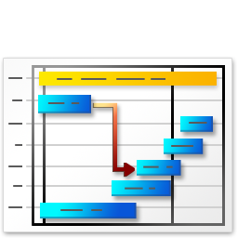

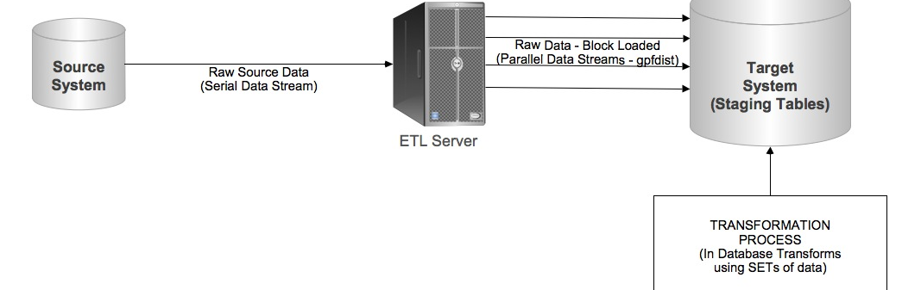
Temporary Tables – Two Use Cases
FILTER
Large table with billions of rows
Subset of larger table(s)
Working with smaller tables
Data transformation
Notes:
The most common use of a temporary table is to take a subset of data from a larger table, reorganize it, and use the results for reporting. This improves overall performance as you are now working on a subset of data instead of a very large dataset. When working with large tables, it is best to avoid performing a union on a large number of queries against large tables. Instead, if you can reduce the size of your table to just what is needed, you see improved performance.
Another use case for working with temporary tables is for data transformation. With the extract, load, and transform method (ELT), you load data directly into the database and then perform your transformations on the data, thereby taking advantage of the Greenplum MPP architecture to improve performance in an area that is often the slowest part of data migration.

Slide 15


Table Storage Models
Heap storage
Default storage model
Supports INSERT, UPDATE, DELETE
Best for:
Data that is often modified
Smaller dimension tables
Supports row-oriented tables
Uses MVCC to support transactions
Append-optimized storage
Append-optimized storage model:
Optimized for data warehouses
Works best with denormalized data
Supports UPDATE and DELETE
Best for:
Older data
Large fact tables
Supports row and column-oriented tables
Supports in-database compression
Uses a Visibility Map (visimap) to hide outdated rows
Notes:
Greenplum provides support for two table storage models with various options:
Heap – Unless otherwise specified, Greenplum tables are created using the heap storage model. Heap tables allow you to add new rows, update existing rows, and remove rows from the table. These types of transactions are seen in OLTP databases where data is often modified after it has been loaded.
Append-optimized – An append-optimized table is optimized for data warehouses. If you follow the strictest definition of the data warehouse, data is not normally modified once it has been loaded into its permanent table. Append-optimized tables do afford some flexibility in that they permit updates and deletes. Append-optimized tables work well for large batch uploads, as opposed to single row inserts. Large fact tables, where data does not normally require changes, are ideal candidates for append-optimized storage. Append-optimized storage does not work with transactions that use serializable isolation levels, as would be seen with single-row inserts. Append-only storage uses a visibility map to mark the rows which should be visible versus those that should not be (due to deletion).
Both storage models support row-oriented tables, whereas column-oriented tables are only supported with append-optimized storage.
Append-optimized storage also supports in-database compression at the table and column levels.

Slide 16
Row-Oriented and Column-Oriented Tables
Row-oriented storage
Column-oriented storage
Works well with data warehouse workloads
Works well for data where you aggregate over a small number of columns
Efficient for data where you modify a single column
Supported on append-optimized storage
Supports mixed workloads (INSERT, UPDATE, DELETE, SELECT)
Is supported with on both heap and append-optimized storage
Notes:
In addition to heap and append-optimized storage models, you can also define your table to be row-oriented or column-oriented.
A row-oriented table supports mixed workloads where you may perform frequent inserts, updates, deletes, and selects.
A column-oriented table, as with append-optimized storage, performs well for data warehouse workloads, where you may be computing aggregations of data over a small number of columns. This type of storage also works well for cases where only certain columns will be modified.

Slide 17
Creating Heap and Append-Optimized Tables
Action | Example
Creating a heap, row-oriented table | CREATE TABLE tc_heap (id int, descr text) DISTRIBUTED BY (id);
Creating an append-optimized, row-oriented table | CREATE TABLE tc_ao (id int, sales float) WITH (appendonly=true) DISTRIBUTED BY (id);
Creating an append-optimized, column-oriented table | CREATE TABLE tc_ao_c (id int, sales float) WITH (appendonly=true, orientation=column) DISTRIBUTED BY (id);
Note: You cannot modify the storage or orientation of a table once defined. You can create a new table with the desired options and migrate your data.
A fly and a flea in a flue
Were imprisoned, so what could they do
Said the fly, let us flee. Let us fly said the flee
So they flew through a flaw in the flue.
A canner exceedingly canny
One morning remarked to his granny
A canner can can anything that he can
But a canner can’t can a can can he?
Notes:
Unless otherwise specified, the default behavior when creating a table is to create a heap storage table with row orientation.
To create an append-optimized table, you must include the clause WITH (appendonly=true) in your table definition.
To specify column orientation, use the WITH (appendonly=true, orientation=column) clause in your table definition.
You cannot change the storage model or orientation of an existing table. You can instead create a new table with the desired storage model and orientation and migrate your data into that table (we did this in the demo, using “CREATE TABLE AS SELECT …”)

Slide 18

Compressing Table Data
Compression Algorithm | Compression Levels | Description | Table-Level Compression | Row-Level Compression
ZLIB | 1 - 9 | Offers the most compact ratio with a potential impact to CPU performance | Supported | Supported
QUICKLZ | 1 | Offers faster, but lower, data compression | Supported | Supported
RLE_TYPE Delta Compression (specific data types) | 1 - 4 | Offers run-length encoding compression for columns based on repeated values | Unsupported | Supported
Question: What type of data do you think would work well with the different offerings of compression?
Notes:
Append-optimized tables support compression at two levels:
Table-level compression is applied to the entire table with support for ZLIB and QuickLZ; RLE_TYPE can also be used at the table level if ORIENTATION=COLUMN.
If ORIENTATION=COLUMN, each column’s compression spec can be applied independently.
The order of precedence for compression specs, from lowest to highest, is table, column, partition, and subpartition.
The various algorithms offer different performance and compression, depending on the data.
ZLIB is the default algorithm that offers greater compression, but at lower speeds. At compression level 1, zlib offers the fastest compression with the lowest ratio, while at 9, it offers the most compact compression, but at the cost of slower speed.
QuickLZ uses less CPU and compresses data faster, but at a lower compression ratio than zlib, and it offers a single compression level.
RLE_TYPE offers run-length encoding (RLE) for column-level compression. With RLE, repeated data is stored as a single value along with a count of the number of times that value is found. As of GPDB 4.3.3, for data stored using RLE, Delta compression is also applied for columns that are defined as BIGINT, INTEGER, DATE, TIME, or TIMESTAMP.

Slide 19
Defining Append-Optimized Compression Tables
Action | Example
Creating a zlib compressed table with compression level 5 | CREATE TABLE tc_ao_zlib5 (id int, sales float) WITH (appendonly=true, compresstype=zlib, compresslevel=5) DISTRIBUTED BY (id);
Creating a quicklz compressed table | CREATE TABLE tc_ao_quicklz (id int, sales float) WITH (appendonly=true, compresstype=quicklz) DISTRIBUTED BY (id);
Creating an AO table with an RLE compressed column and a zlib compressed column | CREATE TABLE tc_ao_rletype ( id int, sales float ENCODING (compresstype=zlib, compresslevel=3), salesdate date ENCODING (compresstype=rle_type)) WITH (appendonly=true, orientation=column) DISTRIBUTED BY (id);
Notes:
When applying compression to the table, you include the compression type and level in the WITH clause of your table definition.
In the first example, the zlib compression algorithm is applied to the table using the clause “WITH (appendonly=true, compresstype=zlib, compresslevel=5)”.
The default compression level is 1
.
The second example shows how to define a QuickLZ compressed table by including the “compresstype=quicklz” option in the WITH clause.
In the third example, compression algorithms are applied, separately, to two columns. Column compression requires the ENCODING clause as part of the column definition. Here, the sales column will use zlib compression at compression level 3, while the salesdate column will use rle_type compression.

Slide 20
Defining Default Table Storage Options
gp_default_storage_options
Options | Level | Command
APPENDONLY BLOCKSIZE CHECKSUM COMPRESSTYPE COMPRESSLEVEL ORIENTATION | Object level | CREATE TABLE … WITH (…)
 | Role level | ALTER ROLE … SET …
 | Database level | ALTER DATABASE … SET …
 | System level | gpconfig …
Highest priority
Lowest priority
Usage: Update default storage options at role level
names=> alter role student set gp_default_storage_options='appendonly=true,compresstype=zlib';
Names=> set role student;
Notes:
The server configuration parameter, gp_default_storage_options, lets you define the storage options to automatically apply when creating a table with the CREATE TABLE command.
The options are a comma separated list, consisting of the storage options, APPENDONLY, BLOCKSIZE, CHECKSUM, COMPRESSTYPE, COMPRESSLEVEL, and ORIENTATION.
The default behavior can be set at various levels of the database:
Role level using the ALTER ROLE SET … command
Database level with the ALTER DATABASE SET … command.
Global level using the gpconfig command.
Specifying options using the CREATE TABLE takes precedence over all other forms. The next order of precedence is the role level, followed by the database level, and then the system level.
In the bottom example, the DBA alters the “student” role to set up storage options specific to that account.

Slide 21
Review
Tablespaces and filespaces
Additional table types (external, temp)
Table storage models
Compression options
Test it out in the lab
Notes:
Filespaces and tablespaces can be combined with partitioning to yield “hot data” vs. “warm data”, o
When designing your table models, consider all aspects of data organization to achieve optimal results for your workload
Utilize heap, append-optimized, row or columnar, and incorporate the appropriate compression types, as required.
Take a few minutes now to elevate your craft by experimenting with these storage options in the lab.
Thank you!

